Slide 1
Project Report
by Unmilan Baruah

Slide 2
Introduction
Sales management has gained importance to meet increasing competition and the need for improved methods of distribution to reduce cost and to increase profits. Sales management today is the most important function in a commercial and business enterprise.
Health is real wealth in the pandemic time we all realized the brute effects of covid-19 on all irrespective of any status. You are required to analyze this health and medical data for better future preparation.
The Agriculture business domain, as a vital part of the overall supply chain, is expected to highly evolve in the upcoming years via the developments, which are taking place on the side of the Future Internet.
Investment is a game of understanding historic data of investment objects under different events but it is still a game of chances to minimize the risk we apply analytics to find the equilibrium investment.
A bird strike is strictly defined as a collision between a bird and an aircraft which is in flight or on a take-off or landing roll. Bird Strike is common and can be a significant threat to aircraft safety. For smaller aircraft, significant damage may be caused to the aircraft structure and all aircraft, especially jet-engine ones, are vulnerable to the loss of thrust which can follow the ingestion of birds into engine air intakes. This has resulted in several fatal accidents.

Slide 3
Objective
This report is a detailed analysis of Amazon Sales Data from 2010 to 2017.
This report is made to analyze the health and medical data, which is provided for better future preparation.
This report aims to find important insights highlighting key indicators and metrics that influence crop production.
This report aims to find key metrics and factors that impacts foreign direct investment in India for the last 17 years from 2000-01 to 2016-17.
This report is a detailed visualization of bird strikes data from 2000 to 2011, which was collected by FAA.

Slide 4
Main KPIs
Amazon Sales Data Analysis: Region/country, revenue, profit, cost, order priority, item type, sales channel.
Heart Disease Analysis: Resting blood pressure, Serum cholestrol, Maximum heart rate achieved, Age, Gender, Chest pain, Resting electrocardiographic results, Exercise induced angina, Fasting blood sugar, Slope of peak exercise ST segment, No. of major blood vessels colored by fluoroscopy, Thalassemia, Oldpeak (ST depression caused by activity in comparison to rest), and Target (patient having heart disease?)
Crop Production Analysis: State, year, season, crop, area (for removing outliers), and crop production.
Bird Strikes Analysis: No. of people injured, actual no. of bird strikes, wildlife (size, and remains collected), origin/states, weather and flight conditions (precipitation, phase of flight, and altitude bin), and aircraft (aircraft size, airline, and airport).
Foreign Direct Investment Analysis: Overall FDI, and Years.

Slide 5
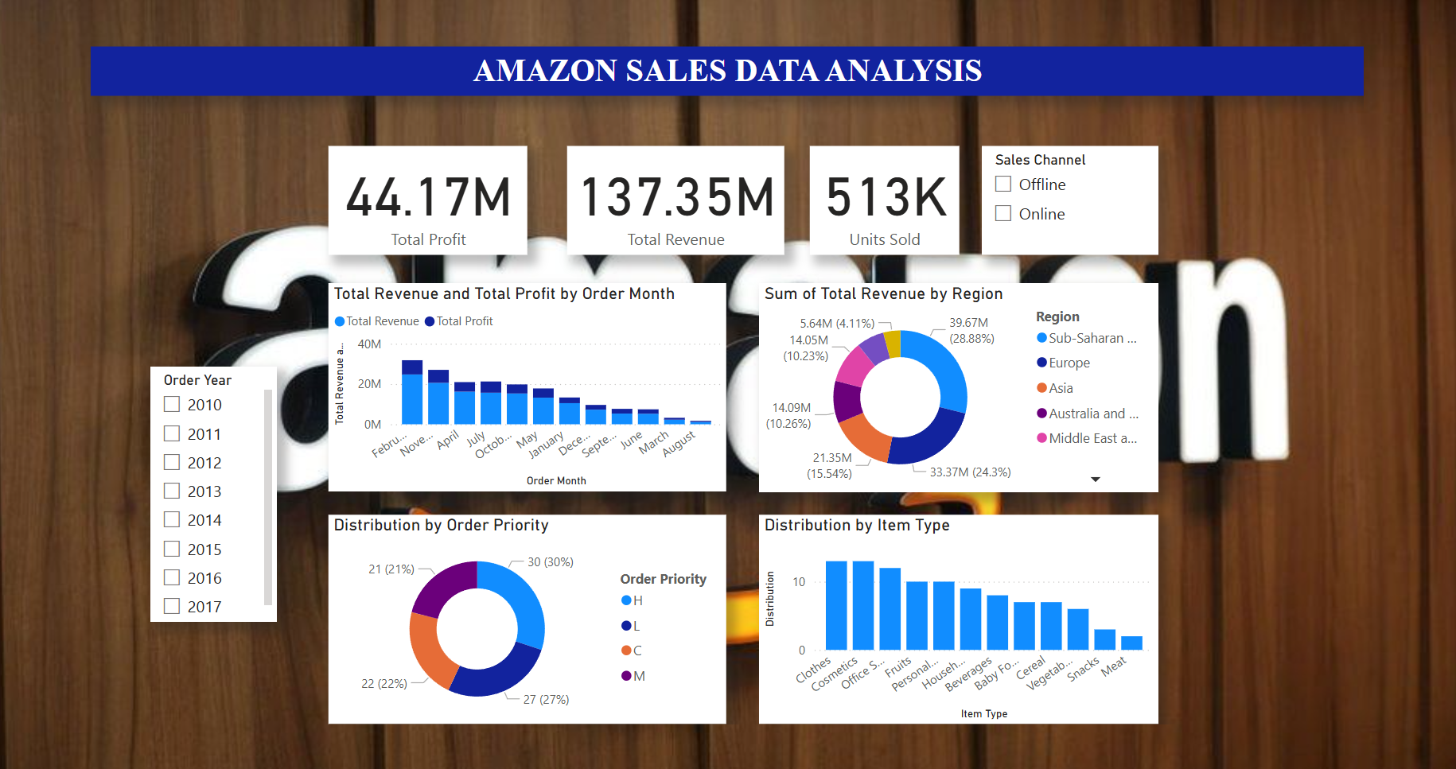
Dashboard (Amazon Sales Data)

Slide 6
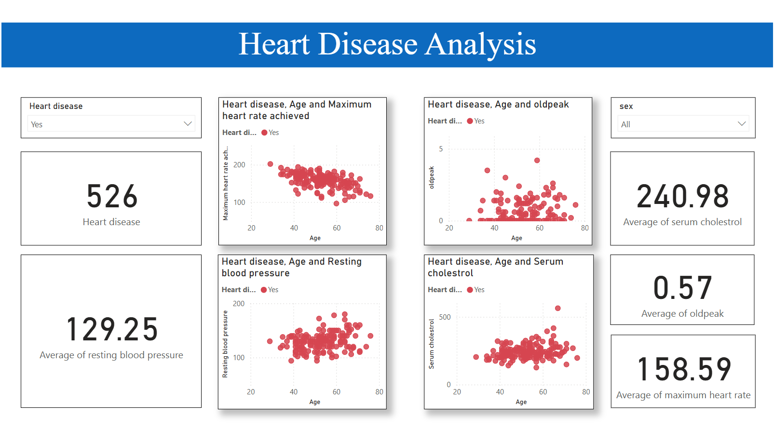
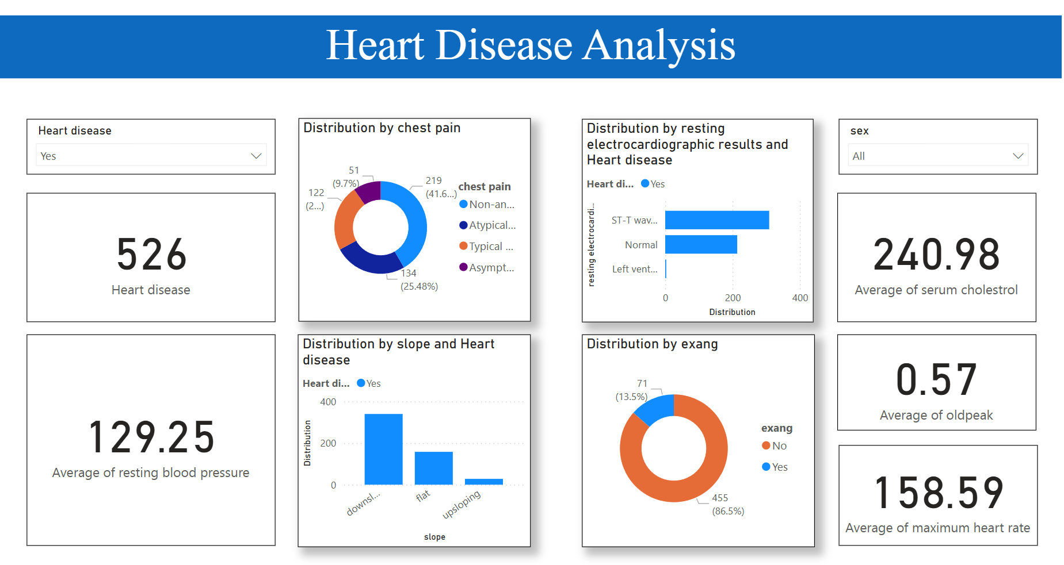
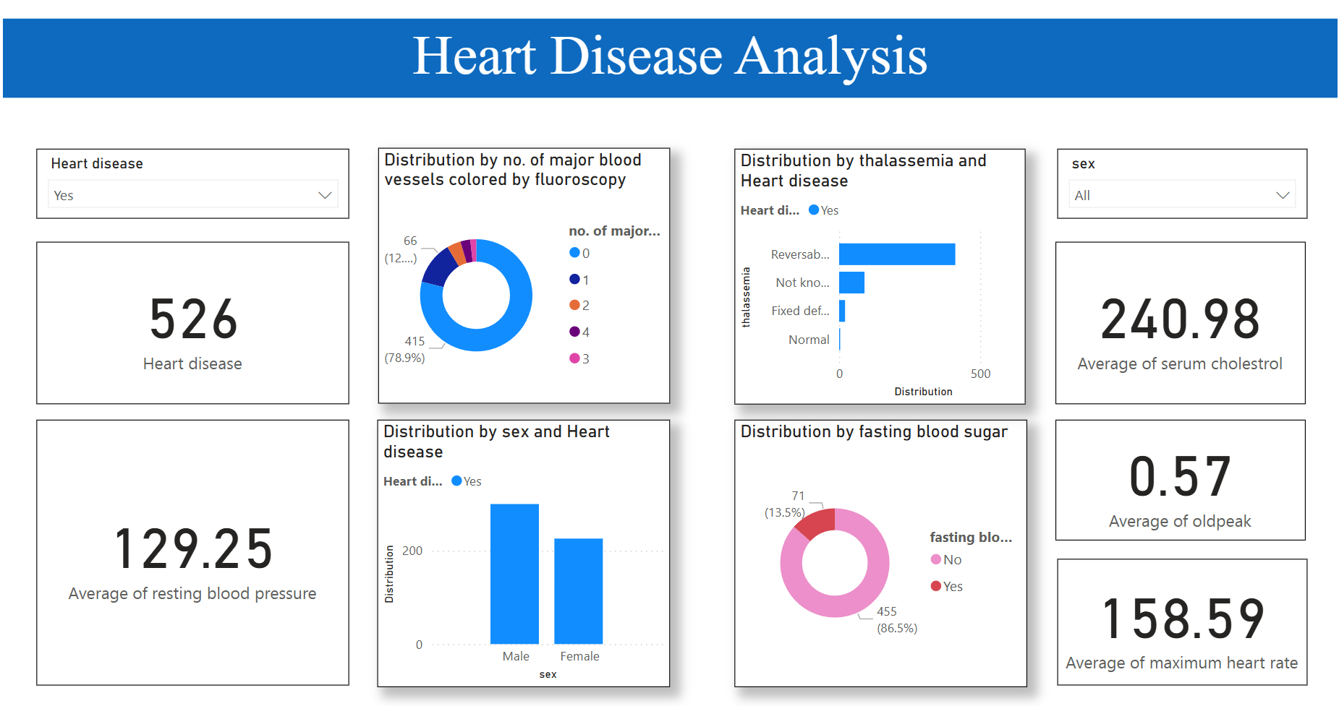
Dashboard (Heart Disease Data)

Slide 7
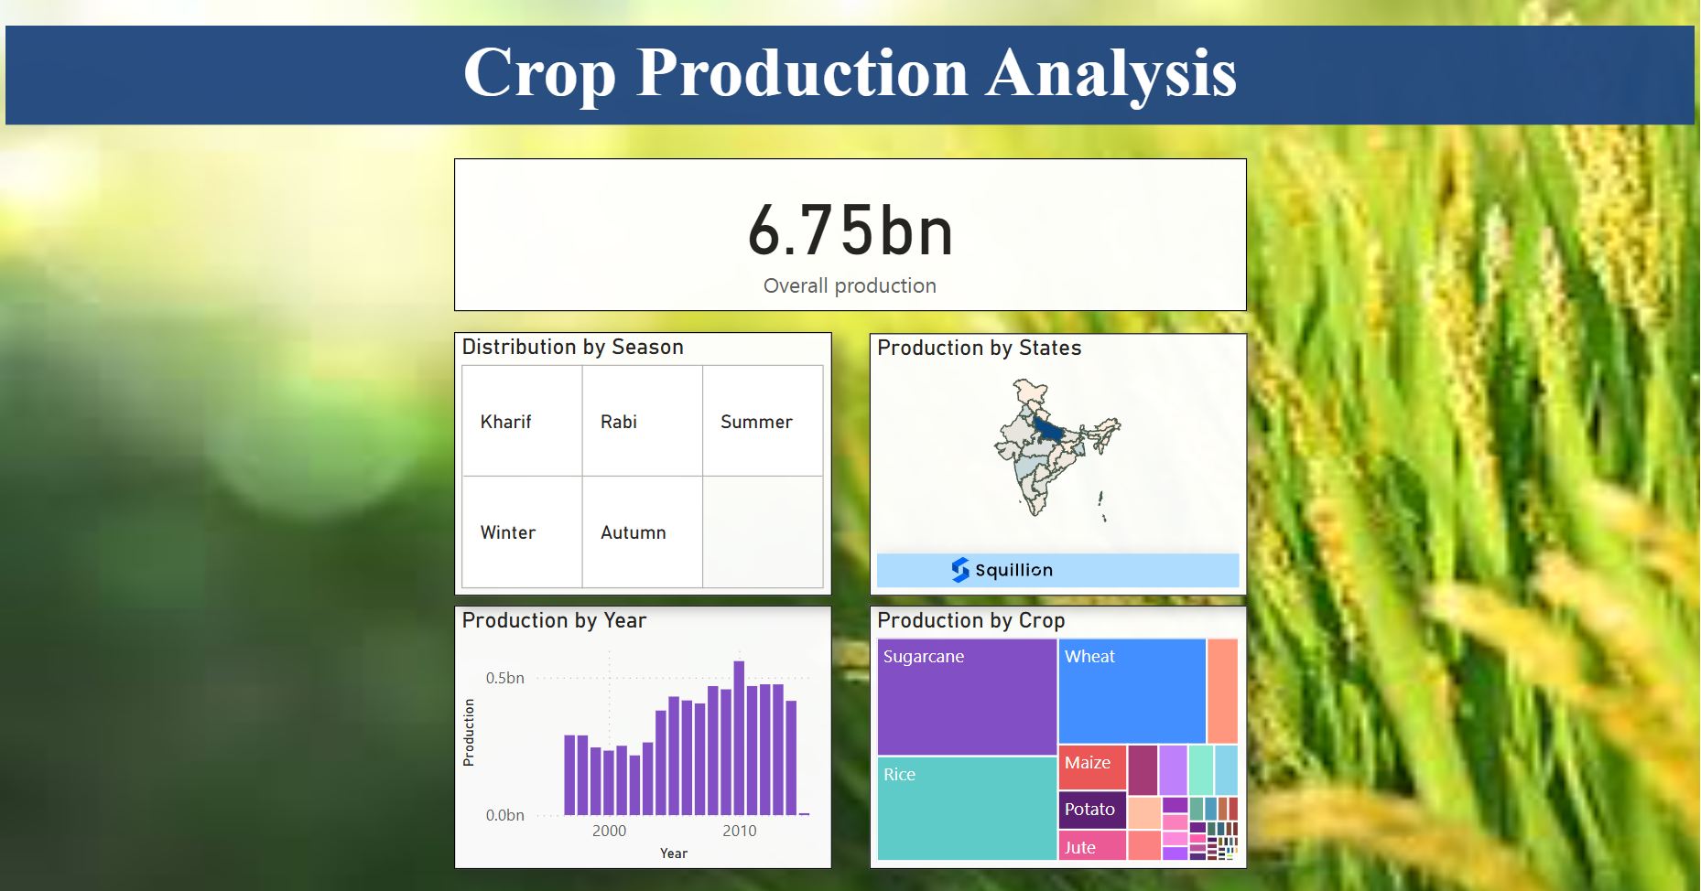
Dashboard (Crop Production Data)

Slide 8
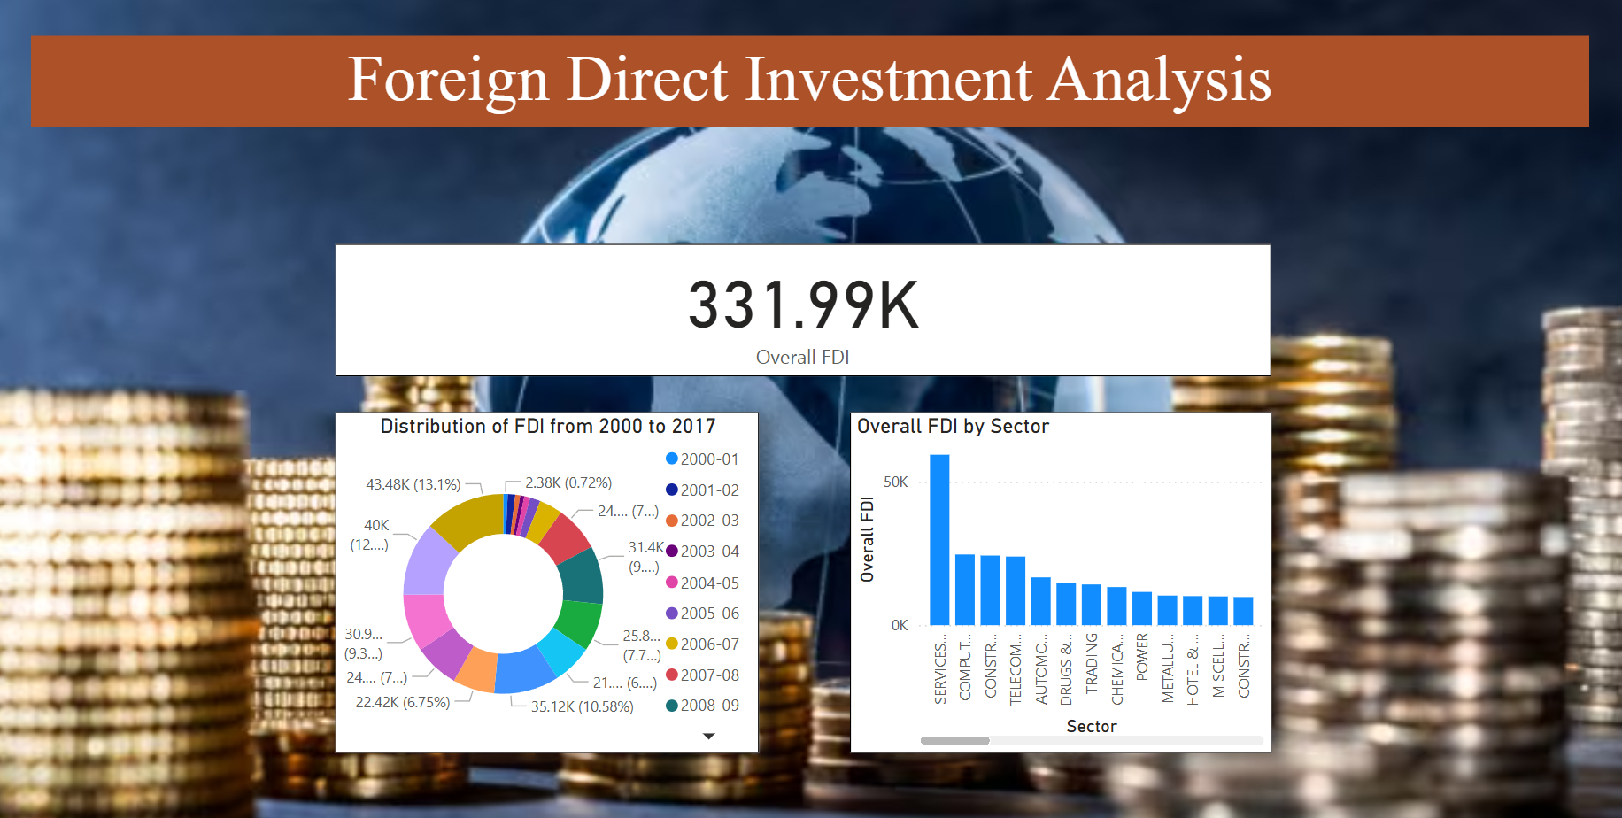
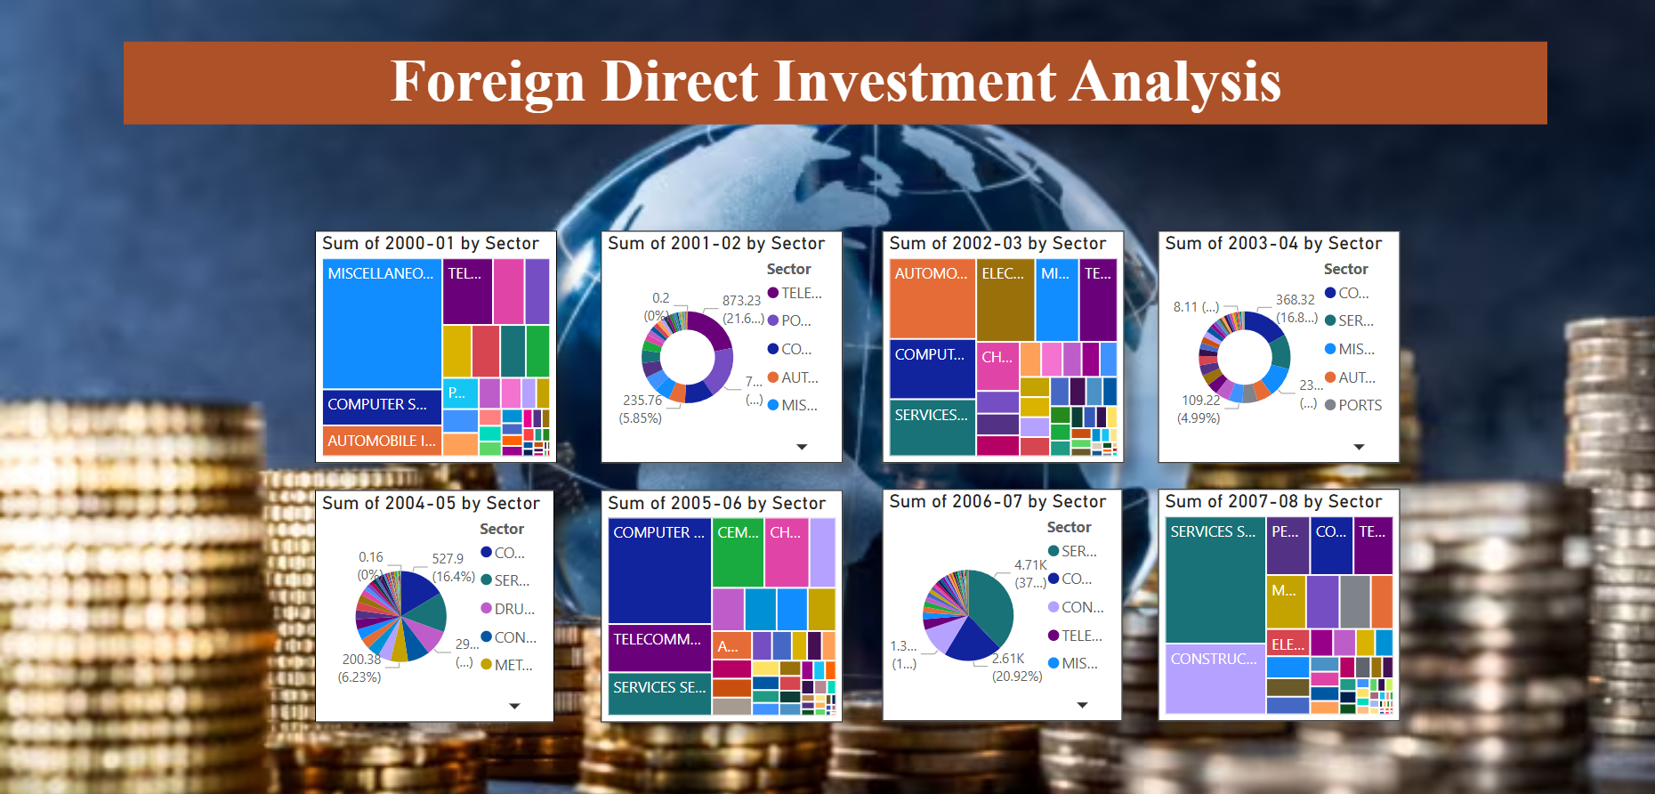
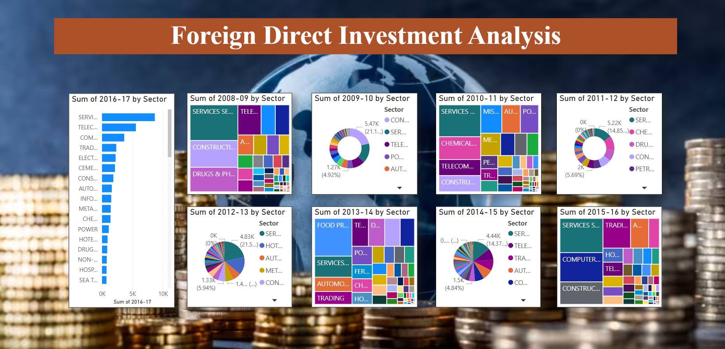
Dashboard (FDI Data)

Slide 9
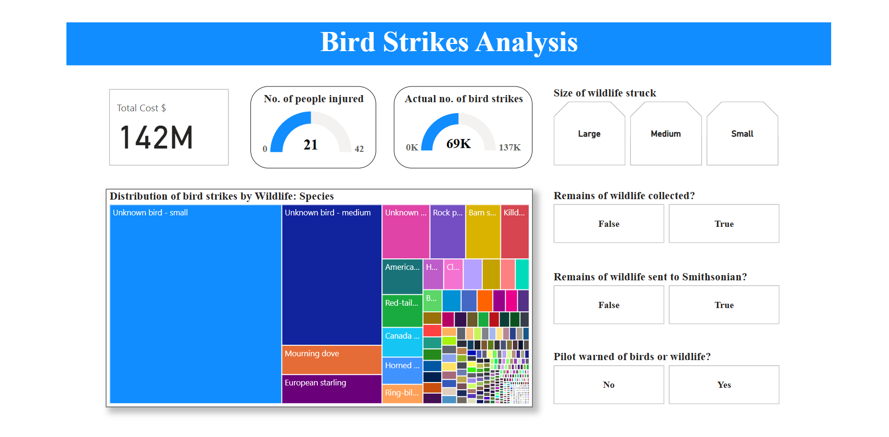
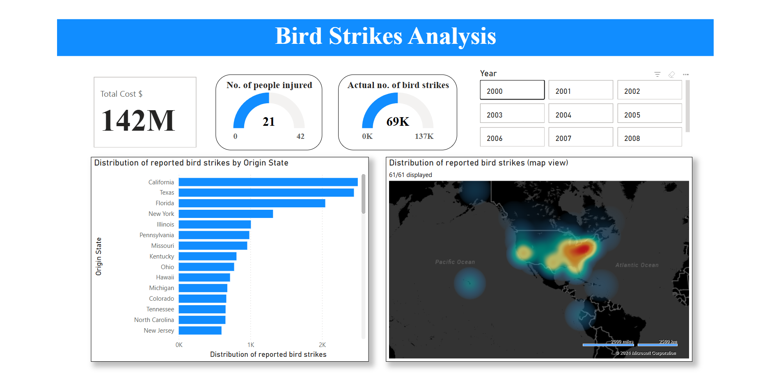
Dashboard (Bird Strikes Data)

Slide 10
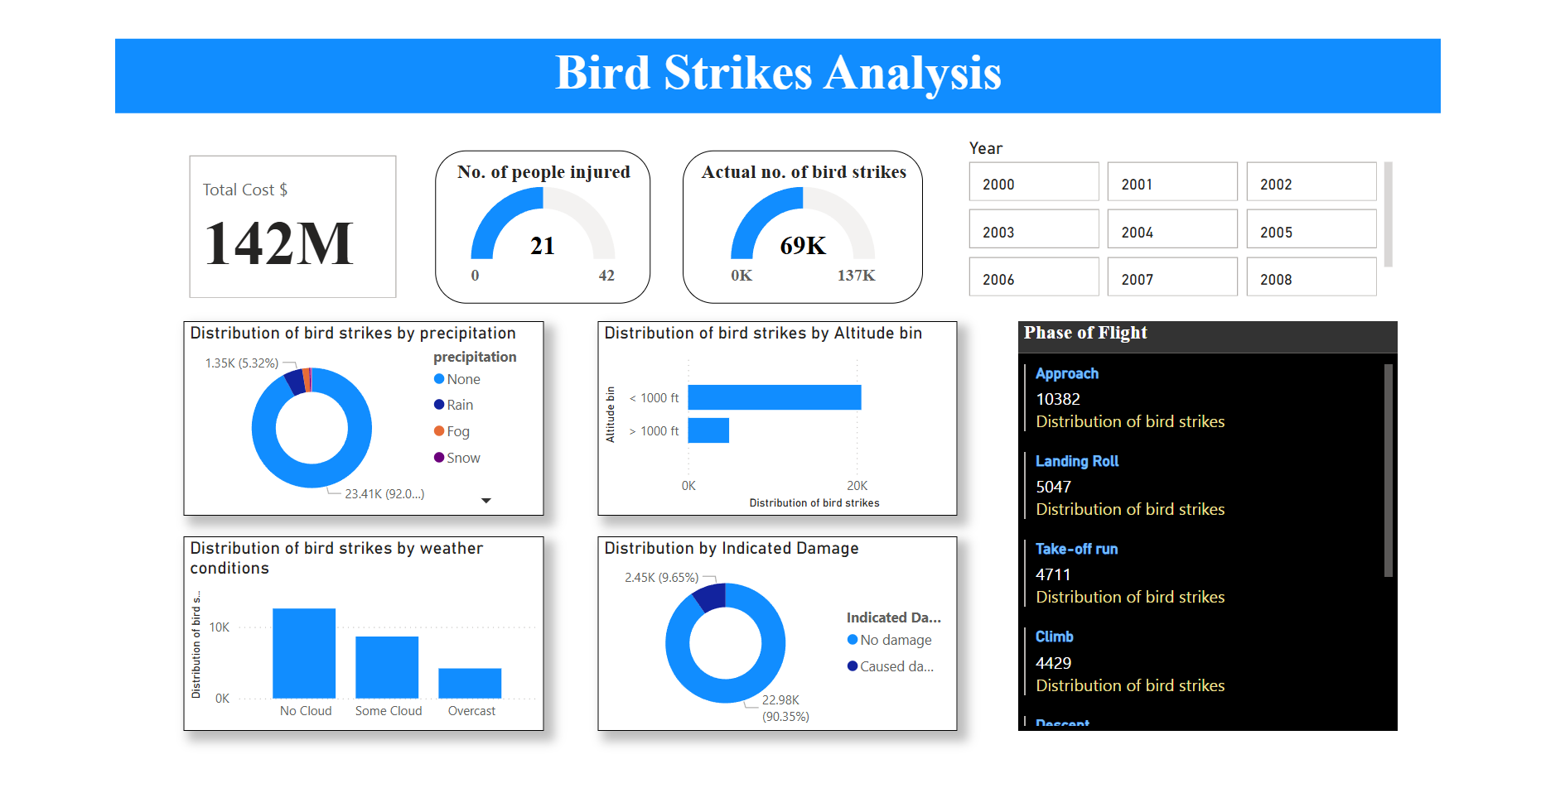
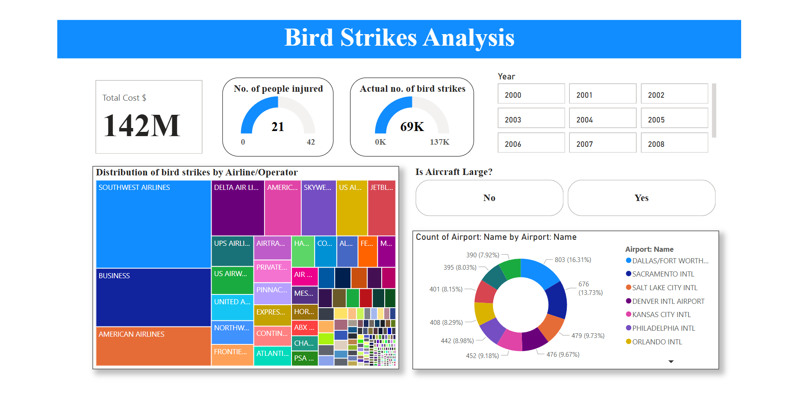
Dashboard (Bird Strikes Data)

Slide 11
Inference (Amazon Sales Data)
Cosmetic products are sold the most in Europe, and Middle East and North Africa regions. So, it is better to promote Cosmetic products in those two regions.
Fruits are are sold the most in Sub-Saharan Africa region. There, it will be better to promote Fruits products in the region, followed by Beverages as these products are the two most preferred item types in the region.
However, necessary changes are needed to made in prices for Fruits products, because the sales from Fruits products is the lowest overall. The same is the case for Beverages, as it has achieved the third most lowest sales overall.
Overall sales are highest for Cosmetics, followed by Household, and Office Supplies. Moreover, Household products are preferred the most in Central America and the Carribean as well as second most preferred products in North America, and Asia. So, it is also necessary to promote Household products with Cosmetics as well.
Also, Office Supplies are the third most preferred products in Asia, and Europe. Thus, necessary to promote Office Supplies, just like Cosmetics and Household products.
The least profit by region is observed in North America. Moreover, only Personal Care, and Household items are sold in this region. So, more study is necessary in the region to enhance the Profit in the region.

Slide 12
Inference (Heart Disease Data)
For those variables having correlation less than 25 percent with the Target variable implies that Age, Resting blood pressure, Serum cholestrol, Fasting blood sugar, and Resting electrocardiographic results has either no impact on chances of suffering from heart diseases or the impact is negligible compared to other variables when taken into account.
For those variables having positive correlation and more than 25 percent with the Target variable clearly shows that increase in Maximum heart rate achieved, Chest pain, and Slope of peak exercise ST segment means increased chances of heart diseases.
From the analysis it can also be observed that health conditions like: Oldpeak, Exercise induced angina, No. of major blood vessels colored by flourosopy, and Thalassemia can be symptoms of some other kind diseases but not necessarily of heart diseases. This is because of the negative correlation of above 25 percent of these health conditions with the Target variable.
Based on the analysis of all the records, men suffer more than women. However, the percentage of women suffering from heart diseases is more than percentage of men. This indicates that women are more prone to heart problems than men.

Slide 13
Inference (Crop Production Data)
Inference (FDI Data)
Clearly, the production of crops is the highest in the state of Uttar Pradesh. This is because of the fact that production of crops is significantly higher in Kharif, and Rabi season.
Production of crops is visible, for all the five seasons, in the states of Kolkata, and Assam. This is also evident from the fact that, along with Kerala, production is observed in these two states during the harsh Winter season.
In all the five seasons, production of Sugarcane, Rice, and Wheat is significantly higher than all other crops. Overall production of above 1 Billion is observed for each of these three crops. This implies that, people in India are fond of Sugarcane, Rice, and Wheat.
Gradual increase in investment has been observed in India from the year 2000 to 2017. This implies that foreign companies are convinced with the political, economic, and social stability of India.
In terms of investment, the COMPUTER SOFTWARE & HARDWARE sector remained dominant from 2003 to 2006.
After 2006, in terms of investment, the SERVICES SECTOR remained the dominant. Even though, the investment is not the highest for SERVICES SECTOR in 2009-10, and 2013-14, the sector still remained the second dominant.

Slide 14
Inference (Bird Strikes Data)
The state of California, Texas, and Florida has extremely high no. of bird strikes overall with above 2000 from each of these three states. So, necessary rules and regulations related for aircrafts are necessary in these states to reduce the high no. of bird strikes in these states.
Strict monitoring of SOUTHWEST AIRLINES, BUSINESS, and AMERICAN AIRLINES is necessary because more than 2000 bird strikes for each of these airlines.
Pilot’s unawareness as well as weather conditions are observed to have less influence on no. of bird strikes. However, smaller aircrafts are necessary to be monitored more than larger aircrafts as more bird strikes are recorded from smaller aircrafts. Also, caution needs to be taken for smaller as well as medium-sized wildlife species.

Slide 15
Thank you

